Slide 1


Pocket Off App
Methodology proposal for Modyo
By
Cristian Segura V.

Slide 2
Summary
My proposal focuses in the methodology to design the best app and the way to measure our success
Shows how would I present results, using the result that I reached in a past job

Slide 3
Step 1: Context Validation

Slide 4
Sub steps
Interview with stakeholders
Validate business objectives -> input to prioritize and define MVP
Know target market -> input for user profiles/personas/buyers
Know goals and restrictions -> input for KPIs definition
Benchmarking
Investigate similar apps to bring ideas to form the basis of the product
Define User (Buyer) Personas
Define profiles according to business goals

Slide 5
Interview w/S.H.
Stakeholders insights
Mission:
Incentivate monthly budget management and achieve user’s personal goals like: going to events (favourite’s band show, soccer matches…) or buying stuff (clothes, videogames…)
For:
University students
Priorities:
Android App before christmas
KPIs:
1000 downloads in first week, 10000 downloads in first month

Slide 6

Benchmarking Results
Benchmarking
Moneyfy:
Pro’s: Multi-plattform, Budget mode, easy to add a register, easy to see expenses per category
Con’s: No motivational features
Good Practice: User friendly graphics

Slide 7
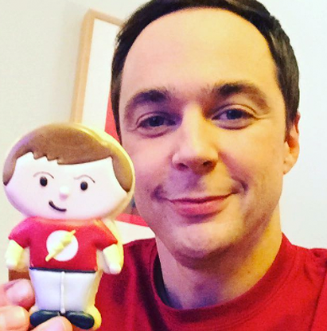
User Personas
To segment user profiles per savings goals: sibarita, músico, deportista, carretero, geek, gamer
User Persona “Geek”
Profile
He is an introverted guy but loves to hang out with his close friends group
In his group, he promotes playing boardgames
He has a collection of boardgames, which he is proud
He prefers not eating sometimes to save money to buy the next gameboard game
Goals
Save money to buy goardgames without sacrifices (like eating)
Frustrations
He spends money in other non important things (like comic pop figures)
He does not have a regular income, in times of need he works as teacher
Worries and doubts
Sheldon is not good in acquiring new habits
He does not track his money spendings regularly
Sheldon
23 years old
Studies Theorical Physics at Stanford
“It’s better not eating than eating alone”

Slide 8
Step 2: Product Design

Slide 9
Sub steps
Users and Stakeholder Hypothesis / elevator pitch
User Story Mapping w/MVP definition

Slide 10
Elevator Pitch
“We believe that with Pocket Off App, our clients will be able to purchase their happyness source (activities/stuffs), rather than with other apps (or without sacrifices) and we will succed if users saves 15% of their monthly income, and achieve their personal goals in their personal time definition”

Slide 11
User Story Mapping – MVP and Releases
Costumer Journey
User registration and profile | Set goals | Add expenses | Show expenses | Show suggestions | Trigger motivational messages | Share discounts in favourite activities | Show monthly results
Personal data and expected income | % saving and time frame | One by one manually | List |  | Static messages at half the month |  | List
Social network integration | By stuff/activity | Track online spendings | Graphics |  | Static messages at half the Budget loss |  | Graphics
Favourite activities info. integration | Suggest goals automatically |  | History Graphics |  | Dynamic messages triggered at keypoints |  | Per stuff
MVP
Features per value
R1
R2

Slide 12
Step 3: Prototyping

Slide 13
Sub Steps
Build a mockup quickly, maybe even in paper
Validate it with stakeholder
Build a navigable wireframe

Slide 14
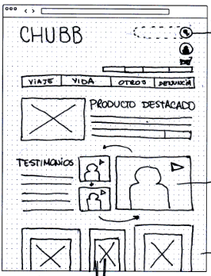
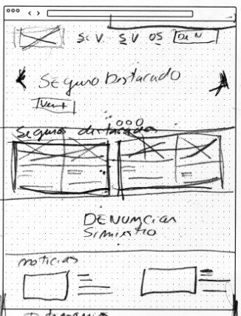
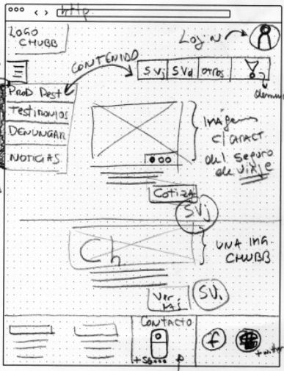
Paper Mockups
Source: My own personal mockups in other jobs

Slide 15
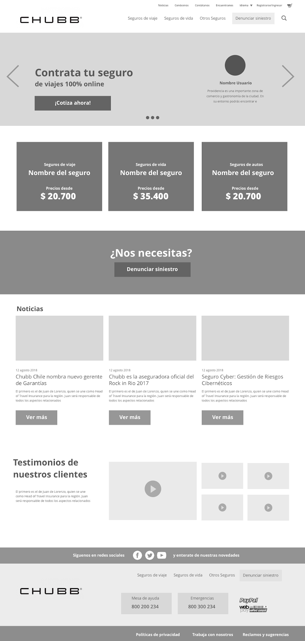
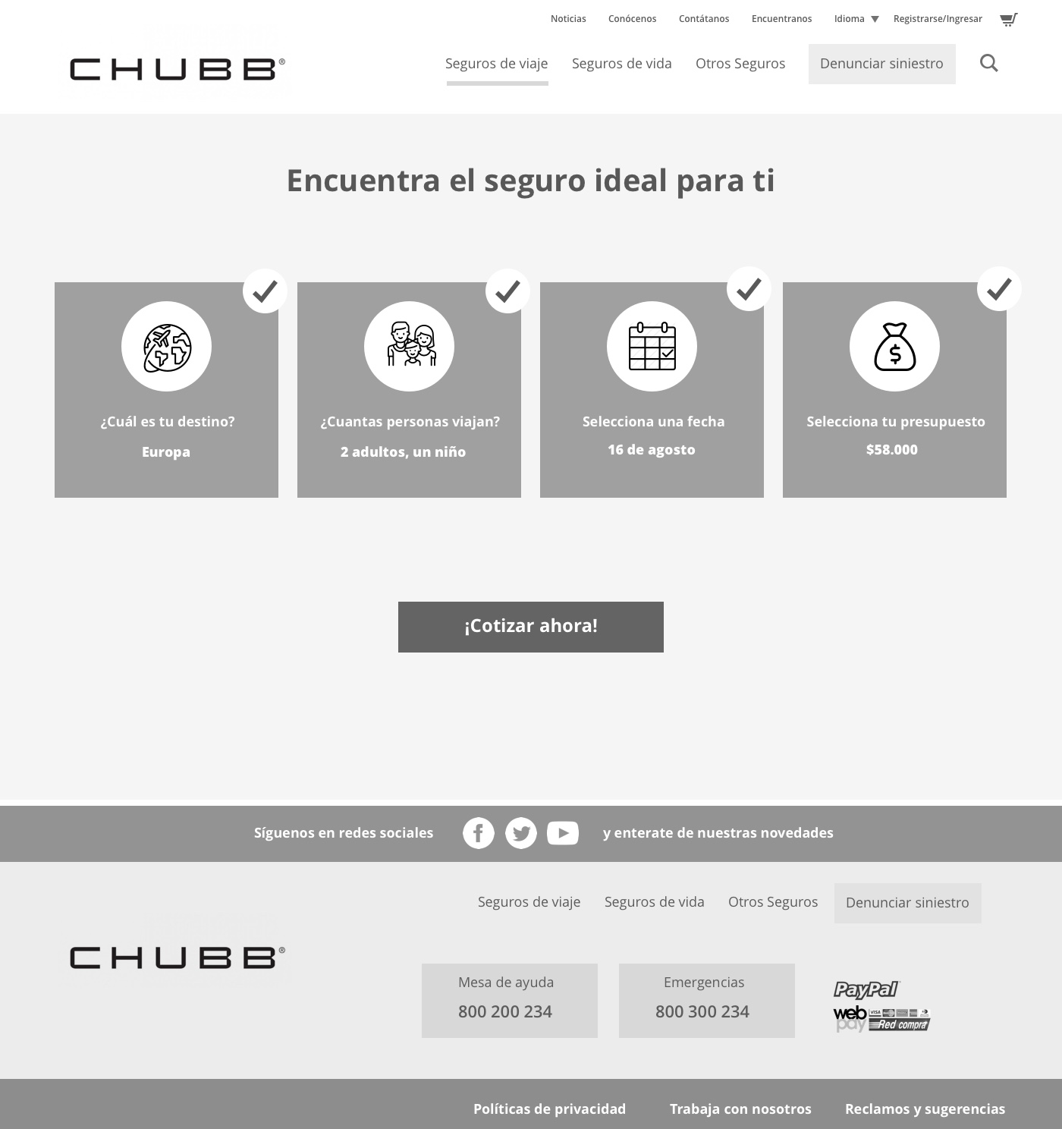
Navigable Wireframe
Source: My own personal mockups in other jobs

Slide 16
Step 4: Product Validation

Slide 17
Substeps
Heuristic Evaluation, Usability Testing and Findings Inform
Validate wireframe with user interviews by selecting 5 users per profile
Present the top findings to stakeholders
Select which ones to improve
Show final prototype

Slide 18

Findings Inform
Used scale
Impulsadores
Elementos que ayudan a los usuarios a cumplir sus metas y pueden facilitar
el onboarding, la usabilidad y/o conversión.
Desorientadores
Elementos que causan confusión o desconcierto pero no inhiben
el cumplimiento de las metas.
Inhibidores
Interacciones o componentes que desmotivan al usuario continuar con el flujo
la interacción con el sistema que no permiten al usuario lograr sus objetivos,
afectando fuertemente el cumplimiento de los objetivos del negocio
Bloqueantes
Interacciones o componentes que no permiten al usuario lograr sus objetivos,
afectando fuertemente el cumplimiento de los objetivos del negocio
Source: My own personal mockups in other jobs

Slide 19
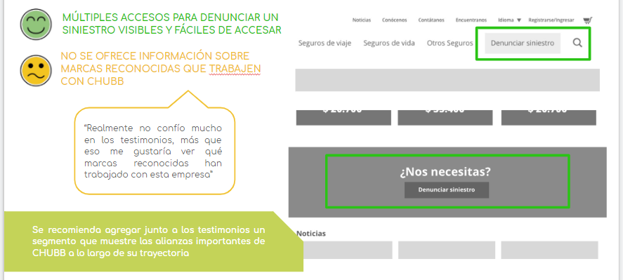
Findings Inform
Source: My own personal mockups in other jobs

Slide 20

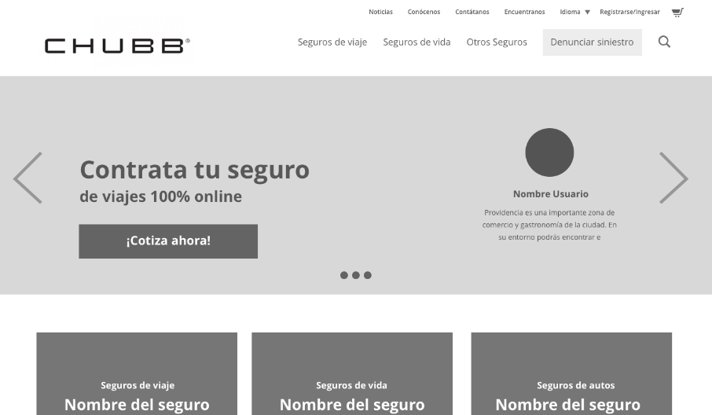
Final Corrected Prototype
Source: My own personal mockups in other jobs

Slide 21
Final Corrected Prototype
Link to navigable final prototype, like:
https://projects.invisionapp.com/share/JKNA04Q3Y7S#/screens
Source: My own personal mockups in other jobs

